Slide 1
Computational Physics (Lecture 16)
PHY4061

Slide 2
Discretization of the equation
The essence :
discretization of the continuous variables,
the spatial coordinates and time.
Rectangular coordinate system :
discretize ∂ A(r, t)/∂ri ,
∂²A(r, t)/∂ri ∂rj , ∂ A(r, t)/∂t, and ∂²A(r, t)/∂²t, where ri or rj is either x, y, or z.

Slide 3
Sometimes, need to deal with a situation similar to having a spatially dependent diffusion constant
for example, to discretize∇· D(r)∇A(r, t).
Here A(r, t) is a generic function.
We can apply the numerical schemes developed in basic numerical methods part for first-order and second-order derivatives for all the partial derivatives.
we can use the two-point or three-point formula for the first-order partial derivative

Slide 4
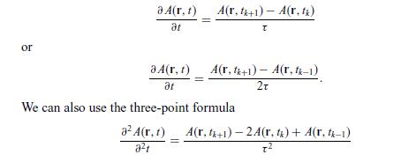
Three point formula
for the second-order derivative. Here t_{k} = t and τ = t_{k+1} − t_{k} = t_{k} − t_{k−1}.

Slide 5
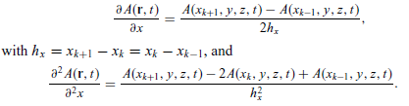
same formulas can be applied to the spatial variables as well, for example
The partial differential equations can then be solved at discrete points.

Slide 6
Above scheme is hard to deal with a discrete mesh that is not uniform or with an inhomogeneity such as ∇· D(r)∇A(r, t),
we may need to introduce some other discretization scheme.
Any rough idea on how to deal with the problem?
We can construct a functional from the field of the solution in an integral form.

Slide 7
The differential equation is recovered from functional variation.
This is in the same spirit as deriving the Lagrange equation from the optimization of the integral.
The advantage here is that we can discretize the integral first and then carry out the functional variation at the lattice points.

Slide 8
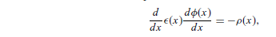

The one-dimensional Poisson equation:
for x ∈ [0, L], as an illustrative example. Here ε(x) is the electric permittivity
that has a spatial dependence.
For simplicity, let us take the boundary condition
φ(0) = φ(L) = 0. We can construct a functional
Leads to the Poisson equation if we take:

Slide 9

If we use the three-point formula for the first-order derivative in the integral and the trapezoid rule to convert the integral into a summation, we have

Slide 10
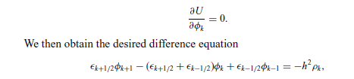
We have used φ_{k} = φ(x_{k} ) for notational convenience and have used ε_{k−1/2} = ε(x_{k−1/2}) as the value of ε(x) in the middle of the interval [x_{k−1}, x_{k} ].
Now if we treat each discrete variable φ_{k} as an independent variable, the functional variation becomes a partial derivative

Slide 11
This scheme is extremely useful when the geometry of the system is not rectangular or when the coefficients in the equation are not constants.
For example, we may want to study the Poisson equation in a cylindrically or spherically symmetric case, or diffusion of some contaminated materials underground where we have a spatially dependent diffusion coefficient.

Slide 12
The stationary one-dimensional diffusion equation is equivalent to the one-dimensional Poisson equation if we replace ε(x) with D(x) and ρ(x) with S(x).
The scheme can also be generalized for the time-dependent diffusion equation.

Slide 13
The matrix method for difference equations
When a partial differential equation is discretized and given in a difference equation form, we can generally solve it with the matrix methods.
In general, when we have a differential equation with the form Lu(r, t) = f (r, t), where L is a linear differential operator of the spatial and time variables, u(r, t) is the physical quantity to be solved, and f (r, t) is the source,
we can always discretize the equation and put it into the matrix form Au = b,

Slide 14
where the coefficient matrix A is from the discretization of the operator L, the column vector u is from the discrete values of u(r, t) excluding the boundary and initial points, and b is the known vector constructed from the discrete values of f (r, t) and the boundary and initial points of u(r, t).
The time variable is usually separated with the Fourier transform first unless it has to be dealt with at different spatial points.

Slide 15
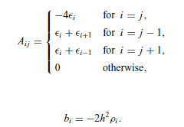
For example, the difference equations for the one-dimensional Poisson equation obtained in the preceding section can be cast into such a form.
This matrix representation of the difference equation resulting from the discretization
of a differential equation is very general.

Slide 16
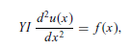
Example: a person is sitting at the middle of a long bench supported at both ends.
Assume that the length of the bench is L.
If we want to know the displacement of the bench at every point, we can establish the equation for the curvature at different locations from Newton’s equation for each tiny slice of the bench.
where u(x) is the curvature (that is, the inverse of the effective radius of the curve
at x), Y is Young’s modulus of the bench, I = t³ w/3 is a geometric constant, with
t being the thickness and w the width of the bench, and f (x) is the force density
on the bench.
Because both ends are fixed, the curvatures there are taken to be
zero: that is, u(0) = u(L) = 0.

Slide 17
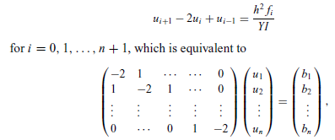
If we discretize the equation with evenly spaced intervals, that is, x₀ = 0, x₁ = h, . . . , x_{n+1} = L, via the three-point formula for the second-order derivative, we have
with u₀ = u_{n+1} = 0, as required by the boundary condition, and bi = h² fi /YI .
We can easily solve the problem with the Gaussian elimination scheme or the
LU decomposition scheme

Slide 18
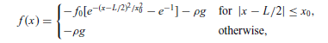
ei = ci = 1 and di = −2. Assume that the force distribution on the bench is given by
with f0 = 200 N/m and x0 = 0.25 m, and that the bench has a length of 3.0 m,
a width of 0.20 m, a thickness of 0.030 m, a linear density of ρ = 3.0 kg/m, and
a Young’s modulus of 1.0 × 10⁹ N/m2. Here g = 9.80 m/s² is the magnitude of the gravitational acceleration

Slide 19
// A program to solve the problem of a person sitting
// on a bench as described in the text.
import java.lang.*;
public class Bench {
final static int n = 99, m = 2;
public static void main(String argv[]) {
double d[] = new double[n];
double b[] = new double[n];
double c[] = new double[n];
double l = 3, l2 = l/2, h = l/(n+1), h2 = h*h;
double x0 = 0.25, x2 = x0*x0, e0 = 1/Math.E;
double rho = 3, g = 9.8, f0 = 200;
double y = 1e9*Math.pow(0.03,3)*0.2/3;
// Evaluate the coefficient matrix elements
for (int i=0; i<n; ++i) {
d[i] = -2;
c[i] = 1;
b[i] = -rho*g;
double x = h*(i+1)-l2;
if (Math.abs(x) < x0)
b[i] -= f0*(Math.exp(-x*x/x2)-e0);
b[i] *= h2/y;
}
// Obtain the solution of the curverture of the bench
double u[] = tridiagonalLinearEq(d, c, c, b);
// Output the result in every m time steps
double x = h;
double mh = m*h;
for (int i=0; i<n; i+=m) {
System.out.println(x + " " + 100*u[i]);
x += mh;
}
}
// Method to solve the tridiagonal linear equation set.
public static double[] tridiagonalLinearEq(double d[],
double e[], double c[], double b[]) {...}
}

Slide 20
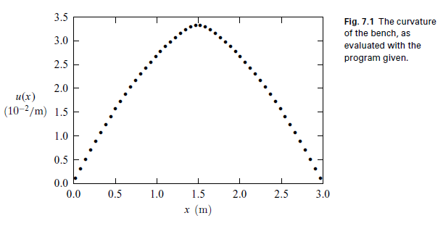
The numerical result for the curvature of the bench calculated with the above
program is illustrated here. Under these realistic parameters, the bench
does not deviate from the original position very much. Even at the middle of the
bench, the effective radius for the curve is still about 30 m.

Slide 21
When the equation is discretized into a difference equation, it becomes extremely simple with a symmetric, tridiagonal coefficient matrix.
In general, all one-dimensional problems with the same mathematical structure can be solved in the same fashion, such as the one-dimensional Poisson equation or the stationary one-dimensional diffusion equation.

Slide 22
If we split the coefficient matrix among the coordinates correctly, we can still preserve its tridiagonal nature, at least, in each step along each coordinate direction.
As long as the coefficient matrix is tridiagonal, we can use the simple LU decomposition to obtain the solution of the linear equation set.
Sometimes we may also need to solve the linear problem with the full matrix that is no longer tridiagonal. We can just apply the methods we learned in the matrix chapter to solve them.
Such as household algorithm.

Slide 23
The relaxation method
a functional can be constructed for the purpose of discretizing a differential equation.
The procedure for reaching the differential equation is to optimize the functional.
In most cases, the optimization is equivalent to the minimization of the functional.
A numerical scheme can therefore be devised to find the numerical solution iteratively, as long as the functional associated with the equation does not increase with each new iteration.

Slide 24
The solution of the differential equation is obtained when the functional no longer changes.
This numerical scheme, formally known as the relaxation method, is extremely powerful for solving elliptic equations, including the Poisson equation, the stationary diffusion equation, and the spatial part of the wave equation after the separation of variables.

Slide 25
the basic idea of the relaxation method: a guessed solution that satisfies the required boundary condition is gradually modified to satisfy the difference equation within the given tolerance.
So the key is to establish an updating scheme that can modify the guessed solution gradually toward the correct direction, namely, the direction with the functional minimized.

Slide 26
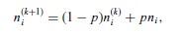
the following updating scheme
where n^{(k)}_{i} is the solution of the kth iteration at the ith lattice point; n_{i} is given
from Eq. (7.69) with the terms on the right-hand side calculated under n^{(k)} _{i} .
p is an adjustable parameter restricted in the region p ∈ [0, 2].
Reexamine the bench problem.
D(x) = 1 and S(x) = −f (x)/(Y I).

Slide 27
// A program to solve the problem of a person sitting
// on a bench with the relaxation scheme.
import java.lang.*;
public class Bench2 {
final static int n = 100, m = 2;
public static void main(String argv[]) {
double u[] = new double[n+1];
double d[] = new double[n+1];
double s[] = new double[n+1];
double l = 3, l2 = l/2, h = l/n, h2 = h*h;
double x0 = 0.25, x2 = x0*x0, e0 = 1/Math.E;
double x = 0, rho = 3, g = 9.8, f0 = 200;
double y = 1e9*Math.pow(0.03,3)*0.2/3;
double u0 = 0.032, p = 1.5, del =1e-3;
int nmax = 100;
// Evaluate the source in the equation
for (int i=0; i<=n; ++i) {
s[i] = rho*g;
x = h*i-l2;
if (Math.abs(x) < x0)
s[i] += f0*(Math.exp(-x*x/x2)-e0);
s[i] *= h2/y;
}
for (int i=1; i<n; ++i) {
x = Math.PI*h*i/l;
u[i] = u0*Math.sin(x);
d[i] = 1;
}
d[0] = d[n] = 1;
relax(u, d, s, p, del, nmax);
// Output the result in every m time step
x = 0;
double mh = m*h;
for (int i=0; i<n; i+=m) {
System.out.println(x + " " + 100*u[i]);
x += mh;
}
}
// Method to complete one step of relaxation.
public static void relax(double u[], double d[],
double s[], double p, double del, int nmax) {
int n = u.length-1;
double q = 1-p, fi = 0;
double du = 2*del;
int k = 0;

Slide 28
while ((du>del) && (k<nmax)) {
du = 0;
for (int i=1; i<n; ++i) {
fi = u[i];
u[i] = p*u[i]
+q*((d[i+1]+d[i])*u[i+1]
+(d[i]+d[i-1])*u[i-1]+2*s[i])/(4*d[i]);
fi = u[i]-fi;
du += fi*fi;
}
du = Math.sqrt(du/n);
k++;
}
if (k==nmax) System.out.println("Convergence not" +
" found after " + nmax + " iterations");
}
}

Slide 29
Note that in the above method we have used the updated u_{i−1} on the right hand side of the relaxation scheme, which is usually more efficient but less stable!
We have also used D _{(i−1/2)}≈(D_{i} + D _{(i−1)})/2, D_{(i+1/2)} ≈ (D_{i} + D_{(i+1)})/2, and D_{(i+1/2)} + D_{(i−1/2)} ≈ 2D_{i}
The multiplication of S(x) by h² is done outside the method to keep the scheme more efficient.
In general, the solution with the LU decomposition is faster and more stable than the solution with the relaxation method for the bench problem.
But the situation reverses in the case of a higher dimensional system.

Slide 30
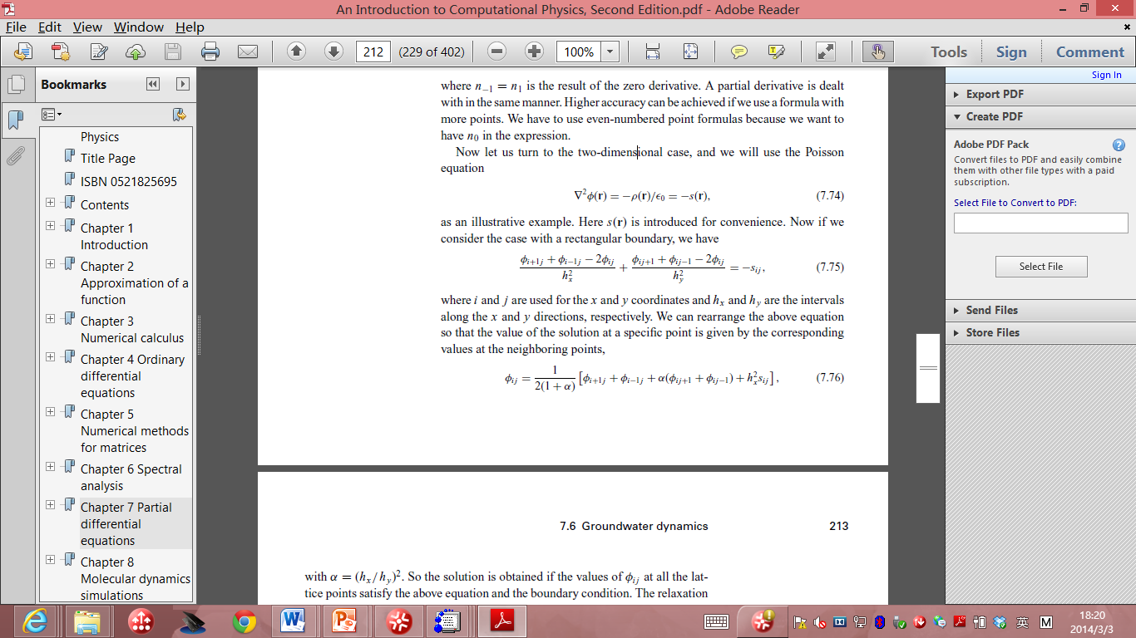
Now let us turn to the two-dimensional case, and we will use the Poisson equation:
if we consider the case with a rectangular boundary, we have
where i and j are used for the x and y coordinates and hx and hy are the intervals
along the x and y directions, respectively.

Slide 31
We can rearrange the above equation so that the value of the solution at a specific point is given by the corresponding values at the neighboring points:
with α = (hx/hy )².

Slide 32
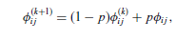
The solution is obtained if the values of φi j at all the lattice points satisfy the above equation and the boundary condition.
We first guess a solution that satisfies the boundary condition.
Then we can update or improve the guessed solution with
where p is an adjustable parameter close to 1. Here φ^{(k)}_{i j} is the result of the
kth iteration, and φ_{i j} is obtained with φ^{(k)}_{i j} used on the right-hand side of the equation on the last page.

Slide 33
The second part of the above equation can be viewed as the correction to the solution, because it is obtained through the differential equation.
The choice of p determines the speed of convergence.
If p is selected outside the allowed range by the specific geometry and discretization,
the algorithm will be unstable.

Slide 34
The optimized p is somewhere between 0 and 2.
In practice, we can find the optimized p easily by just running the program for a few iterations, say, ten, with different values of p.
The convergence can be analyzed easily with the result from iterations of each choice of p.
Mathematically, one can place an upper limit on p but in practice, this is not really necessary, because it is much easier to test the choice of p numerically.

